Slide 1

Edward Jones - Two-step Application Process
David Fanter and Rhonda Powell
Edward Jones ATS System Administrators

Slide 2
Why a two-step application process?
As a financial services company, we require:
  10 years of work history and all education history, including high school and post-secondary education.
    Gateway Questionnaire widgets only allow up to 5 education institutions and 5 places of employment; which does not allow us to collect the level of detail required.
  Outside activity, criminal, financial and regulatory disclosure questions answered and reviewed before hiring a candidate.
    These questions require branching based on country, requisition type, and responses.

Slide 3
What is our process?
Gateway Questionnaire is what we consider our App Part 1
  More of indication of interest and to gather answers to basic qualification questions
    We have 9 Gateway Questionnaires (primary based on requisition type and country, plus an internal Gateway Questionnaire).
    If current associate applies Externally, the first question on the External GQ is asking if they are a current associate and if so, directs them to the Internal GQ which is SSO
    Work Experience Widget
    Education Experience Widget
    Import Profile
    Resume upload, it is preferred, but not required
    Basic eligibility requirements (will auto-close if they do not meet basic qualification)
    Previous employment with Edward Jones
    Licensing information
    Skill questions (score and will auto-close if score is below a specific cut-off score)
    Source information
    EEO information (this is hidden from the recruiting areas)
    10-15 minutes to complete depending on GQ

Slide 4
What is our process?
Rehire Check – if candidate previously worked at EDJ
  If the candidate indicates that they previously worked at EDJ, a RAM will run to move the candidate to Rehire Check status
    A communication, sent by RAM, will then go to Associate Relations to confirm if they are eligible for rehire.
    Once they approve or deny, status is moved to Rehire Check – Clear or Rehire Check – Do Not Move Forward
    If Clear, they move forward to the Recruiter Interview

Slide 5
What is our process?
Recruiter Interview
  We do both recruiter interviews via phone and live or recorded digital interviews with Modern Hire. We are currently not integrated, but we have just started a project to integrate.
  We use Event Manager to schedule interviews
  These recruiter interviews are documented via candidate forms in BrassRing

Slide 6
Q&A
What questions do you have so far?

Slide 7
What is our process?
Invite to App Part 2, if decide to move forward
  Once moved into Invite to App 2 status, App A & B auto post to Candidate Zone
  Can take up to 90 minutes to complete App A & B
  Based on whether the candidate is a US or Canadian candidate, the applications branch with questions specific to each country.
    Three parts – Reason – too large to load if we have all parts combined
      App Part A (535 fields)
        Education History (high school and post-secondary education)
        Work History (must have 10 years of work history, including not employed time periods)
        Licensing information (Real Estate, CPA, CFA, etc.)
      App Part B (689 fields)
        Outside Activities and Criminal, Financial, and Regulatory disclosures
        Utilize a lot of branching to allow further details to be provided if they have a disclosure
      Additional Work History
        Appears if a statement on App A indicates they have more than 8 jobs to enter for Work History to meet the 10-year requirement. The application would be too large and most people do not have more than 8 jobs in 10 years. RAM runs to move the candidate to Additional Work History if Yes and then form posts to the Candidate Zone for the candidate to complete.

Slide 8
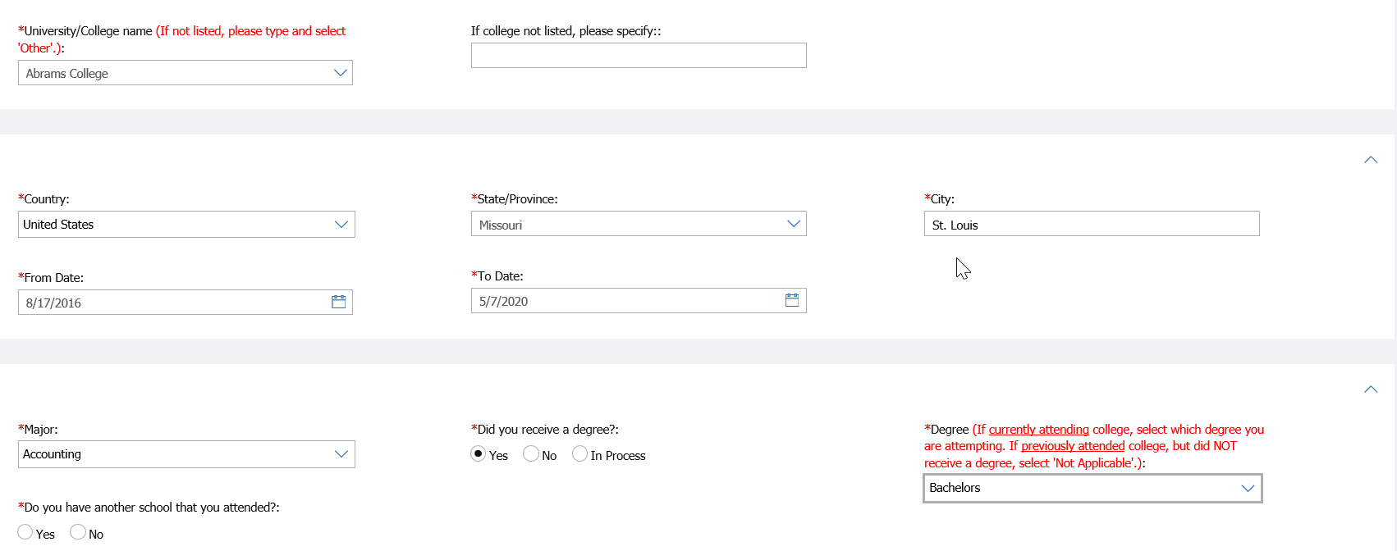
What is our process?

Slide 9
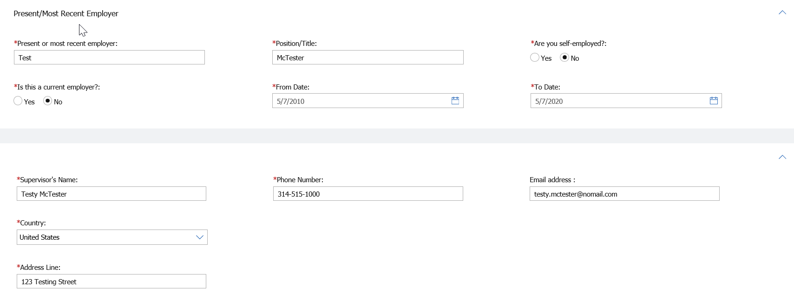
What is our process?

Slide 10
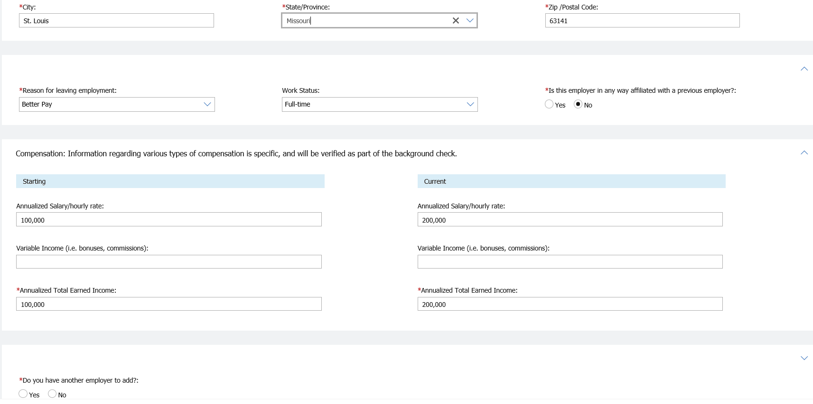
What is our process?

Slide 11
What is our process?
DocuSign for Signature
  After candidate submits the Applications in the Candidate Zone, IBM sends us the PDF of the forms. This is done by posting to the SFTP folder.
  Our IS team has created a program that will pick up the Applications and send it to DocuSign for signature.
  Candidates will then receive an email from DocuSign to electronically sign.
  When signed, DocuSign responds with a response that the forms have been signed (can be declined, voided, or failed as well).
  We have created an XML that updates a response field on a candidate form within BrassRing.
  A RAM runs to read that form and moves the status to Signed (or Declined, Voided or Failed)

Slide 12
What is our process?
If the status moved to Signed, RAM runs to look at App Part B for Disclosures as these must be reviewed by our Compliance department.
We have two RAMS that generate based on App Part B.
  The first RAM runs to review for any Yes answers, then if there are, a candidate form is populated indicating there are Yes answers.
  Another RAM runs off the newly created form to generate a communication which is sent to the Compliance area to review and either approve or deny.
A similar process is done for any Outside Activities that are reported, except a communication is sent to our Field Supervision department.
If the candidate is cleared by our Compliance area, the candidate continues through the hiring process.
  Our business areas review the application for completeness and will repost, have the candidate update, and then re-sign through DocuSign
Through this point in the process, RAMs save us 3.5 FTE

Slide 13
Q&A
What questions do you have?

